Slide 1
Increased temperatures shift flower height distributions and seed dispersal patterns in invasive thistles
Trevor Drees
The Pennsylvania State University
thd5066@psu.edu

Slide 2
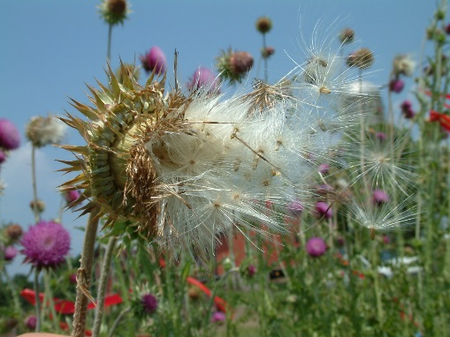
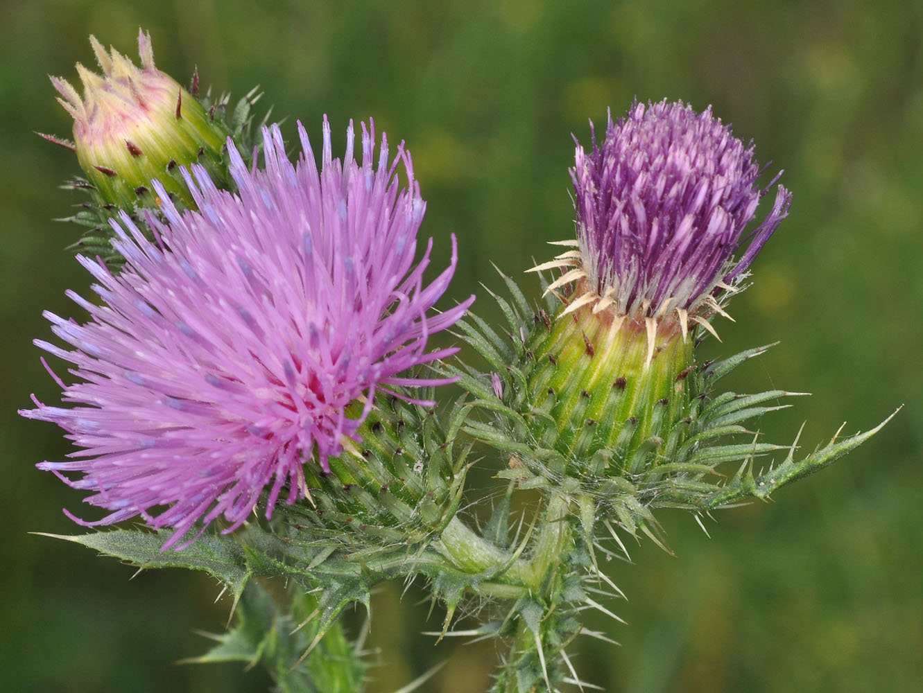
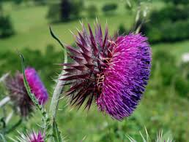
Background & Introduction
Background & Introduction
Study System & Methods
Image source: O. Skarpaas
Results
Discussion & Conclusions
Image source: brc.ac.uk
Image source: web.ewu.edu

Slide 3
Background & Introduction
Background & Introduction
Study System & Methods
Image source: O. Skarpaas
Results
Discussion & Conclusions
Image source: brc.ac.uk
Image source: web.ewu.edu

Slide 4
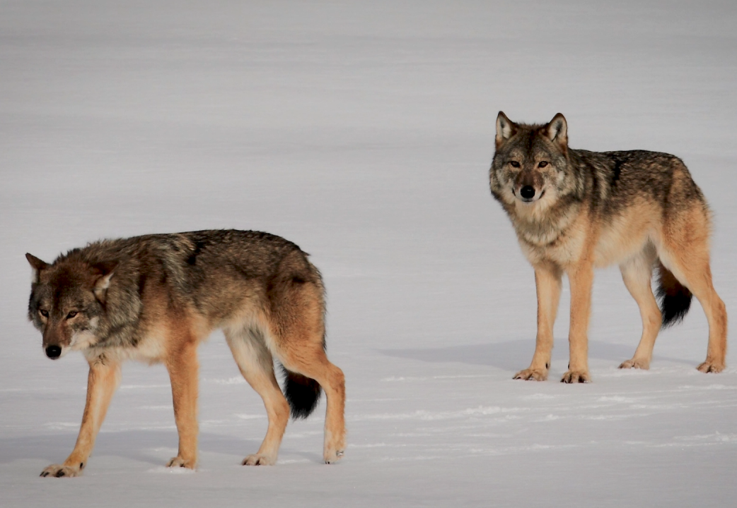
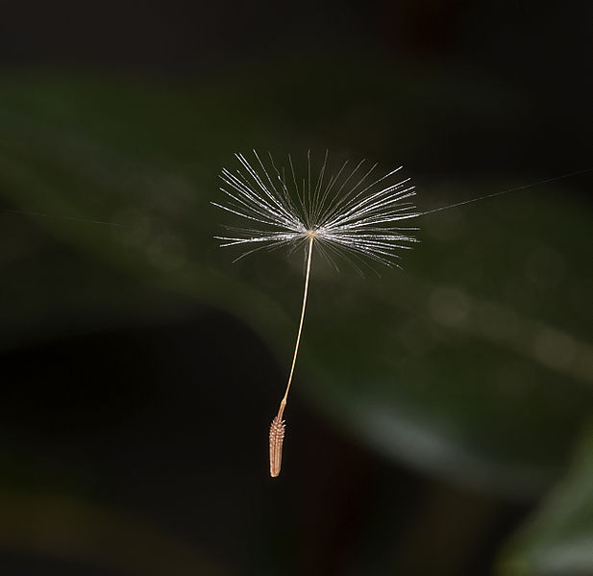
Background & Introduction
What is dispersal?
Image source: pbs.org
Image source: Wikipedia
Any movement of organisms that can possibly generate gene flow.

Slide 5
Background & Introduction
Why quantify dispersal?
We can do a better job of…
Understanding how species distributions shift
Understanding gene flow between populations
Making predictions regarding the spread of invasive species

Slide 6
Background & Introduction
Why quantify dispersal?
We can do a better job of…
… which entails …
Understanding how species distributions shift
Predicting how quickly invasive species spread
Understanding gene flow between populations
Understanding which life stages contribute most to dispersal
Making predictions regarding the spread of invasive species
Understanding which agents most strongly drive dispersal

Slide 7
Background & Introduction
Why quantify dispersal?
We can do a better job of…
… which entails …
Understanding how species distributions shift
Predicting how quickly invasive species spread
Understanding gene flow between populations
Understanding which life stages contribute most to dispersal
Making predictions regarding the spread of invasive species
Understanding which agents most strongly drive dispersal
A better understanding of dispersal in invasive species can help us make more informed management decisions that save time and money

Slide 8
Background & Introduction
Climate change may affect dispersal
Climate change has the potential to affect dispersal of organisms, either by directly affecting dispersal vectors or indirectly by affecting dispersal-related factors.
This includes:
Temperature
Precipitation
Wind speeds
Frequency of extreme events
Image source: O. Skarpaas

Slide 9
Background & Introduction
Climate change may affect dispersal
Climate change has the potential to affect dispersal of organisms, either by directly affecting dispersal vectors or indirectly by affecting dispersal-related factors.
This includes:
Temperature
Precipitation
Wind speeds
Frequency of extreme events
Image source: O. Skarpaas
Wind-dispersed invasive species!

Slide 10
Background & Introduction
Climate change may affect dispersal
Climate change has the potential to affect dispersal of organisms, either by directly affecting dispersal vectors or indirectly by affecting dispersal-related factors.
This includes:
Temperature
Precipitation
Wind speeds
Frequency of extreme events
Could affect growth; seeds released higher and travel further
Image source: O. Skarpaas
Wind-dispersed invasive species!

Slide 11
Background & Introduction
Climate change may affect dispersal
Climate change has the potential to affect dispersal of organisms, either by directly affecting dispersal vectors or indirectly by affecting dispersal-related factors.
This includes:
Temperature
Precipitation
Wind speeds
Frequency of extreme events
Faster wind blows seeds further
Image source: O. Skarpaas
Wind-dispersed invasive species!

Slide 12
Background & Introduction
Climate change may affect dispersal
Climate change has the potential to affect dispersal of organisms, either by directly affecting dispersal vectors or indirectly by affecting dispersal-related factors.
This includes:
Temperature
Precipitation
Wind speeds
Frequency of extreme events
Extreme wind events can carry seeds very long distances
Image source: O. Skarpaas
Wind-dispersed invasive species!

Slide 13
Background & Introduction
Climate change may affect dispersal
Climate change has the potential to affect dispersal of organisms, either by directly affecting dispersal vectors or indirectly by affecting dispersal-related factors.
This includes:
Temperature
Precipitation
Wind speeds
Frequency of extreme events
Image source: O. Skarpaas
Wind-dispersed invasive species!

Slide 14
Background & Introduction
Research goal
Use empirical data and mechanistic models to predict how increases in temperature will alter seed release heights, and thus dispersal patterns, in invasive plant species.
Image source: O. Skarpaas

Slide 15
Background & Introduction
Research goal
Use empirical data and mechanistic models to predict how increases in temperature will alter seed release heights, and thus dispersal patterns, in invasive plant species.
Not all species will exhibit the same responses to temperature increases, though.
We need to choose a species to use as a case study…
Image source: O. Skarpaas

Slide 16
Study System & Methods
Background & Introduction
Study System & Methods
Image source: O. Skarpaas
Results
Discussion & Conclusions
Image source: brc.ac.uk
Image source: web.ewu.edu

Slide 17
Study System & Methods
Study system: invasive thistles
Carduus nutans
Carduus acanthoides
Image source: brc.ac.uk
Image source: web.ewu.edu
“musk thistle”, “nodding thistle”
“plumeless thistle”, “spiny plumeless thistle”

Slide 18
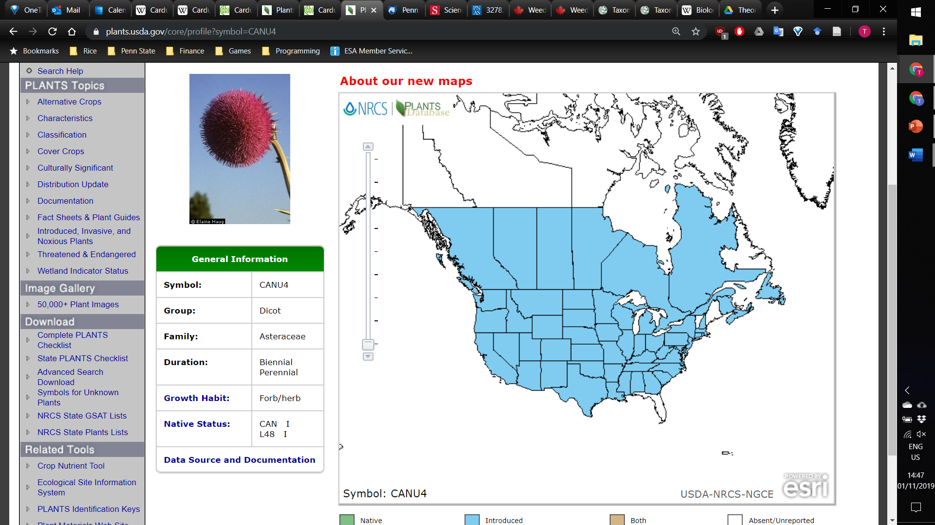
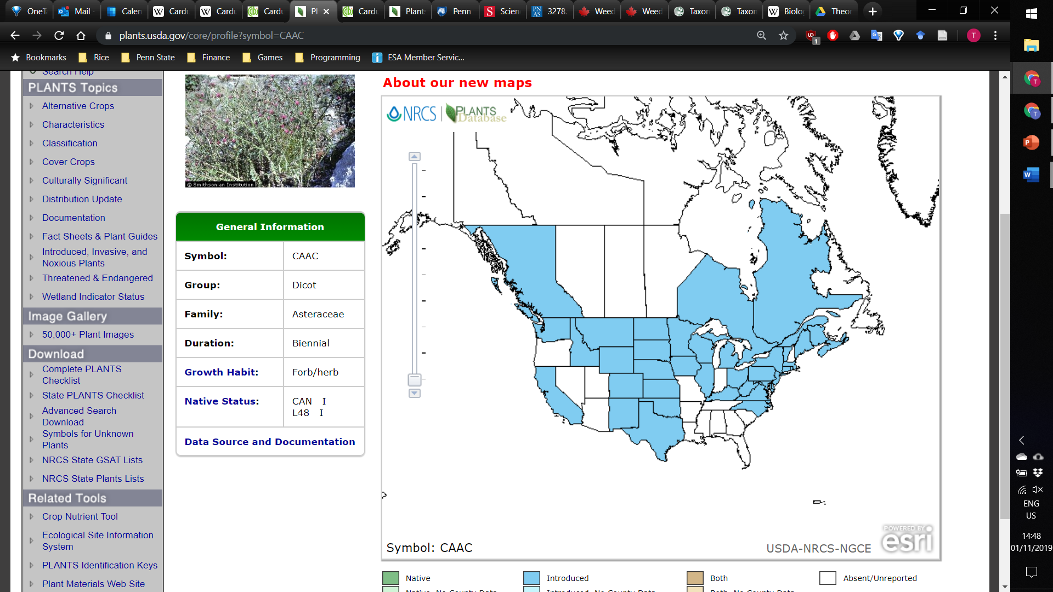
Study System & Methods
Carduus nutans
Carduus acanthoides
Image source: plants.usda.gov
Image source: plants.usda.gov
Introduced
U.S. (All states except AK, FL, HI, ME, VT)
Canada (All provinces except NT, NU, PE, YT)
South America (Chile)
Africa (South Africa)
Australia and New Zealand
Native to Europe and Central Asia
Introduced
U.S. (33 states)
Canada (BC, NB, NS, ON, QC)
South America (Argentina, Uruguay)
Africa (South Africa)
New Zealand
Native to Europe and Central Asia

Slide 19
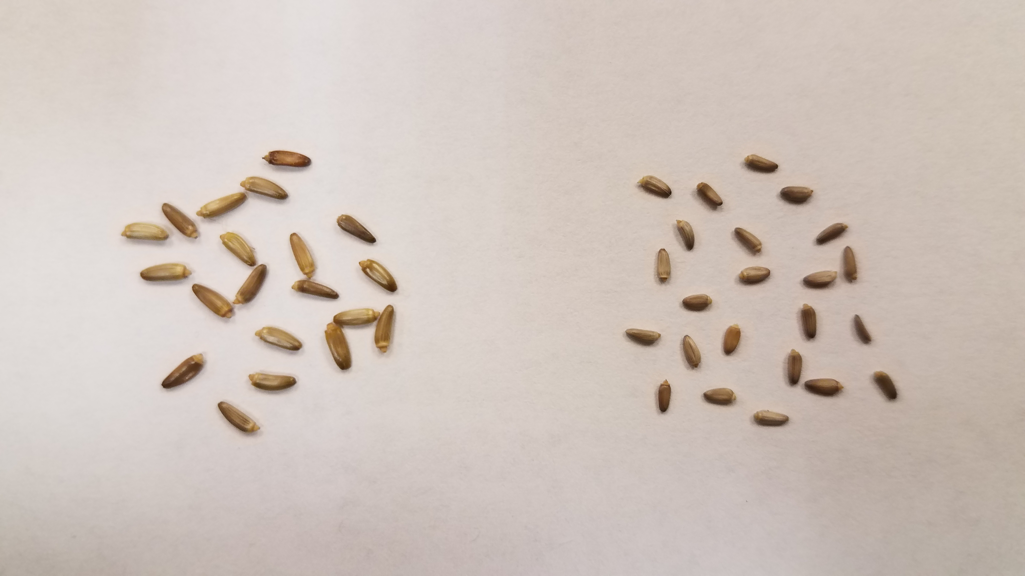
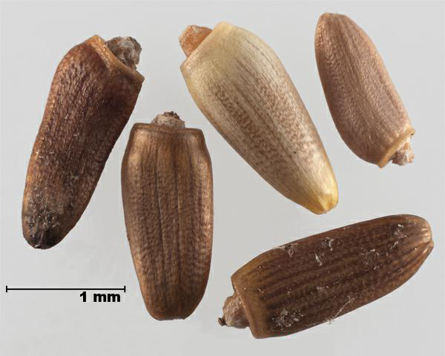
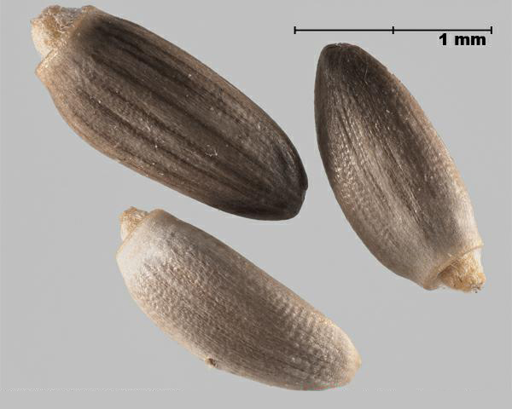
Study System & Methods
Seeds are the propagules through which these thistles are dispersed.
Image source: T. Drees
Carduus nutans Carduus acanthoides
Image source: inspection.gc.ca
Image source: inspection.gc.ca

Slide 20
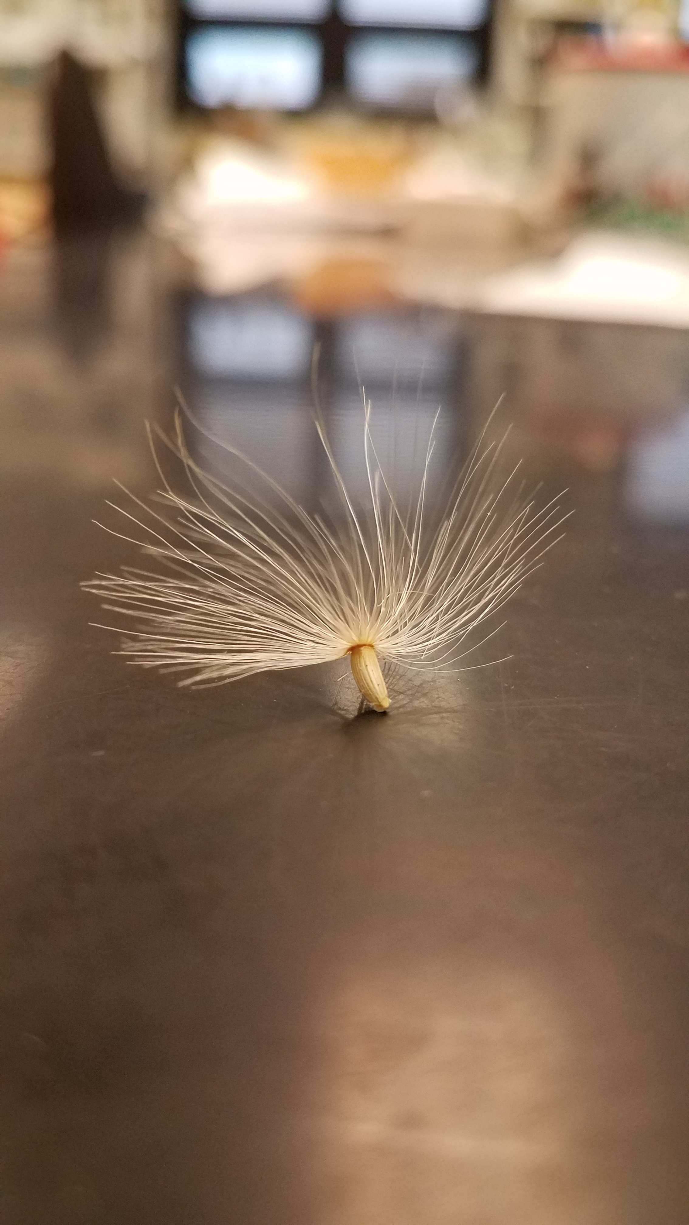
Study System & Methods
Wind is the primary dispersal mechanism.
Image source: O. Skarpaas
Image source: T. Drees

Slide 21
Study System & Methods
Wind is the primary dispersal mechanism.
Image source: O. Skarpaas
Image source: T. Drees
But how do we model this dispersal?

Slide 22
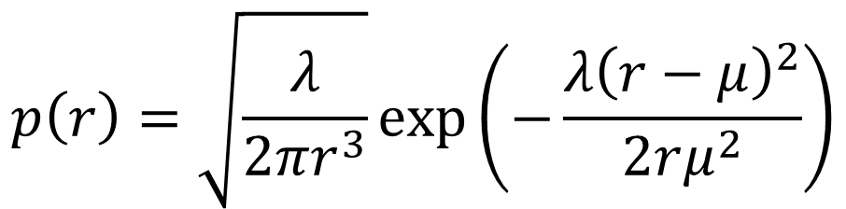
Study System & Methods
Wind dispersal can be simulated using an inverse Gaussian distribution based on a mechanistic fluid dynamics model:
$$p\left(r\right)=\sqrt{\frac{λ}{2πr^{3}}}exp⁡\left(−\frac{λ{\left(r−μ\right)}^{2}}{2rμ^{2}}\right)$$
Katul et al. 2005, Skarpaas and Shea 2007

Slide 23
Study System & Methods
Wind dispersal can be simulated using an inverse Gaussian distribution based on a mechanistic fluid dynamics model:
$$p\left(r\right)=\sqrt{\frac{λ}{2πr^{3}}}exp⁡\left(−\frac{λ{\left(r−μ\right)}^{2}}{2rμ^{2}}\right)$$
Dispersal kernel giving probability density for a seed travelling distance r from release
Katul et al. 2005, Skarpaas and Shea 2007

Slide 24
Study System & Methods
Wind dispersal can be simulated using an inverse Gaussian distribution based on a mechanistic fluid dynamics model:
$$p\left(r\right)=\sqrt{\frac{λ}{2πr^{3}}}exp⁡\left(−\frac{λ{\left(r−μ\right)}^{2}}{2rμ^{2}}\right)$$
Dispersal kernel giving probability density for a seed travelling distance r from release
Scale parameter from:
Mean wind speed
Wind measurement height
Vegetation cover characteristics
Seed release height
Mean/location parameter from:
Mean wind speed
Seed release height
Seed terminal velocity
Katul et al. 2005, Skarpaas and Shea 2007

Slide 25
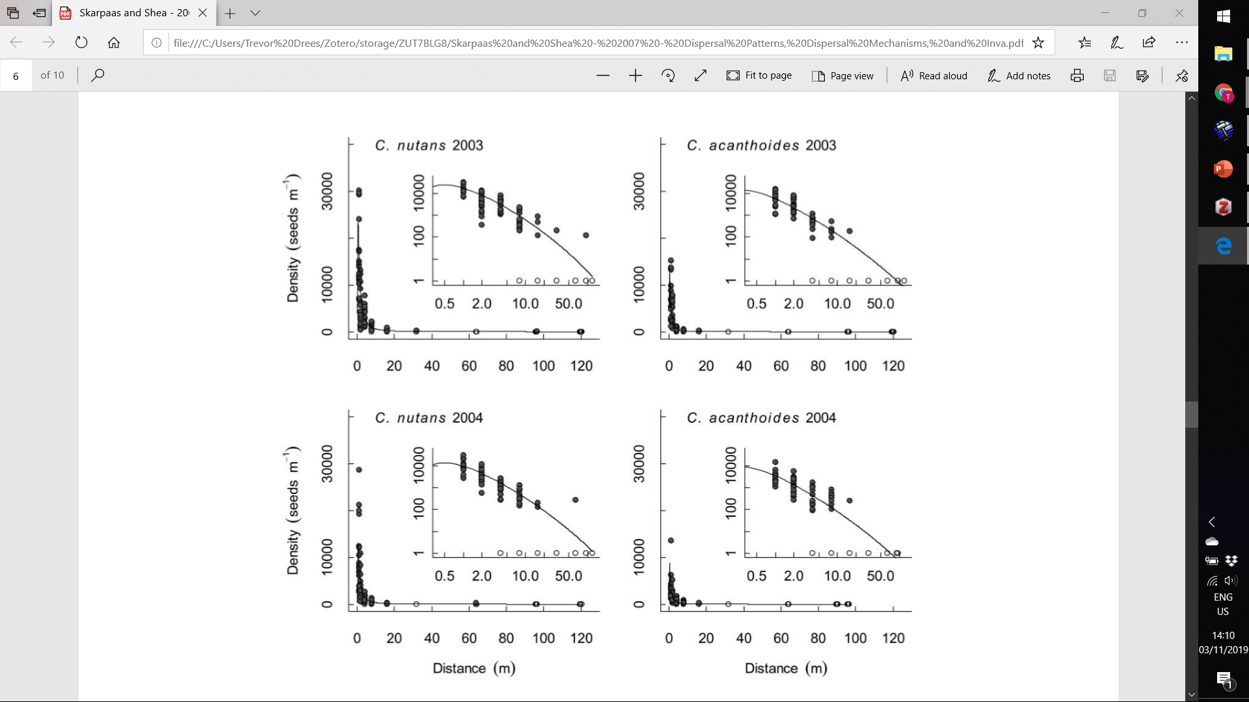
Study System & Methods
This wind dispersal model has been tested in several systems, including in Carduus nutans and Carduus acanthoides, and can quantify dispersal reasonably well.
Densities of seeds collected using seed traps
Predicted seed density based on mechanistic dispersal model
Image source: Skarpaas and Shea (2007)

Slide 26
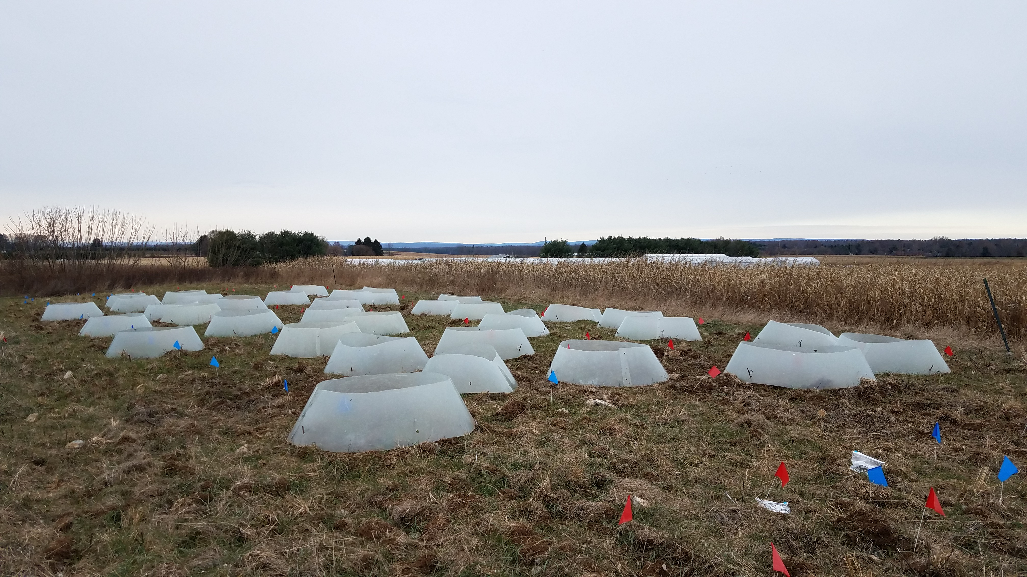
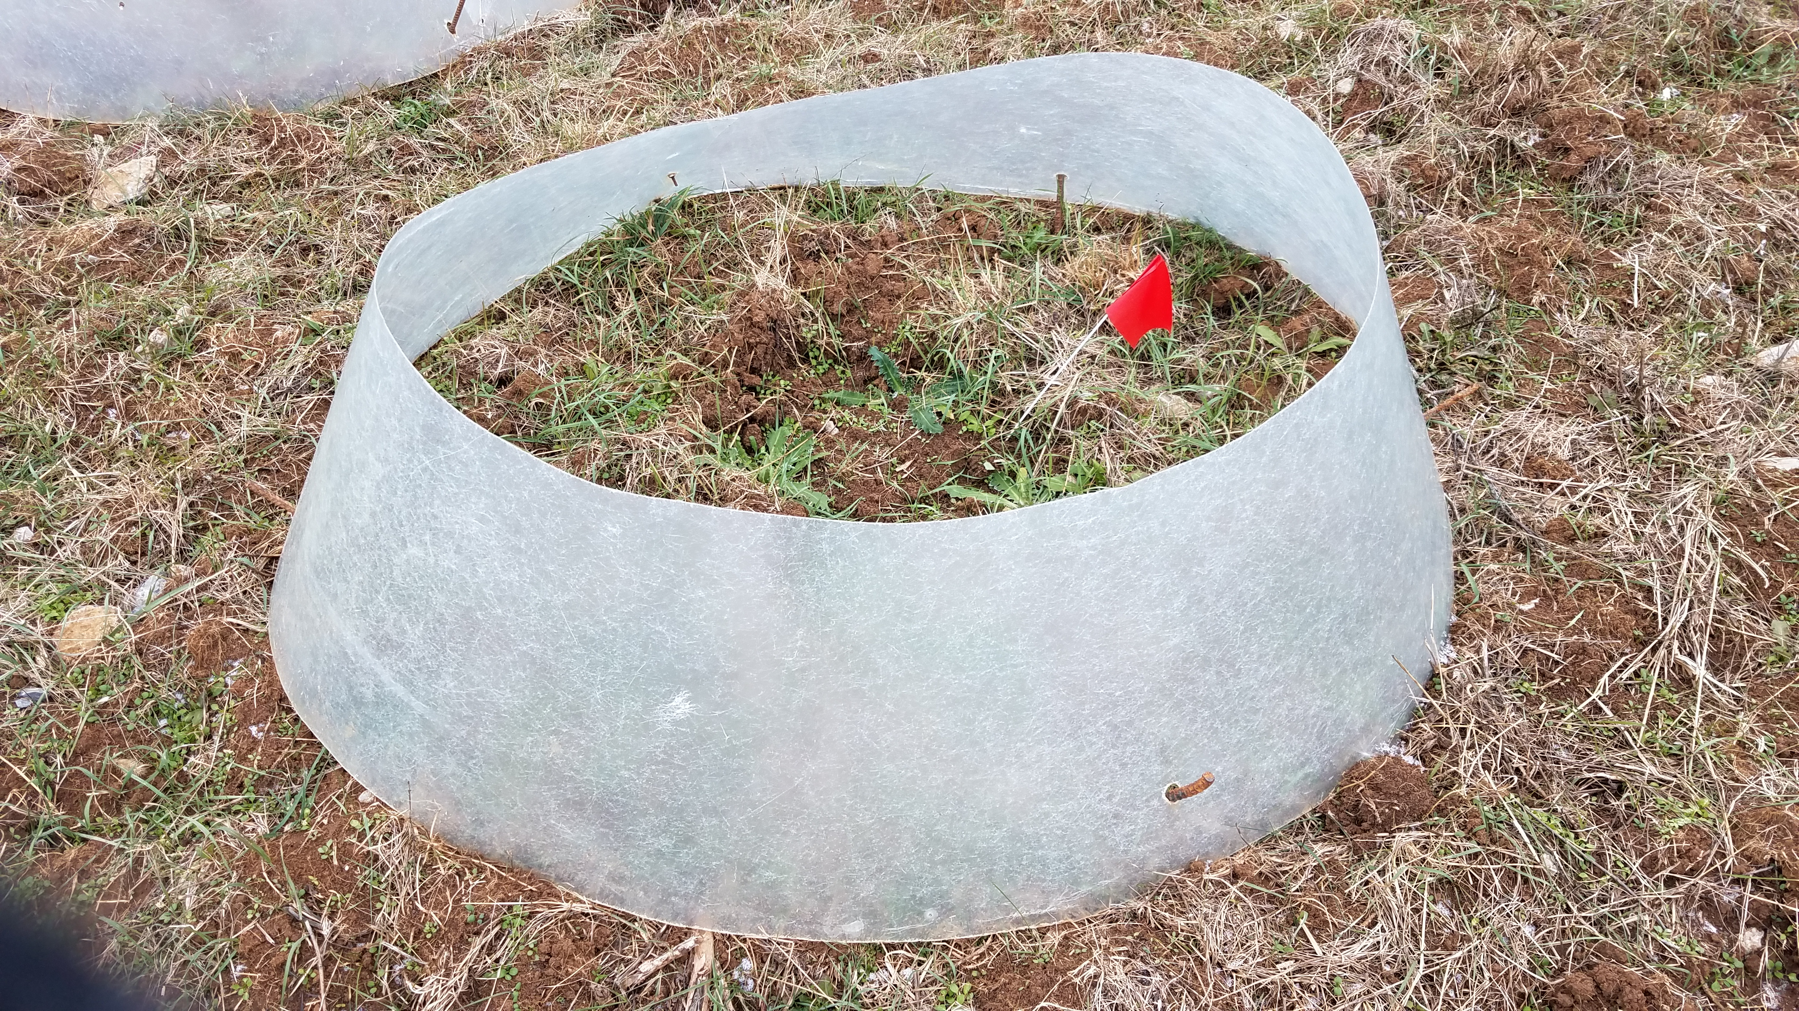
Study System & Methods
How will climate change be incorporated into dispersal models?
Image source: T. Drees
Image source: T. Drees

Slide 27
Study System & Methods
How will climate change be incorporated into dispersal models?
We use a field experiment to examine the effects of warming on flower head height, a key determinant of dispersal distance.
Image source: T. Drees
Image source: T. Drees

Slide 28
Study System & Methods
How will climate change be incorporated into dispersal models?
We use a field experiment to examine the effects of warming on flower head height, a key determinant of dispersal distance.
For treatment blocks of C. nutans and C. acanthoides, half of the individuals received a fibreglass open-top chamber. These chambers simulate a 0.58 °C average increase in ambient temperature, and do not affect soil moisture or snow depth (Zhang et al. 2011). Chambers were places around the thistles in the autumn and remained for the duration of the experiment.
Image source: T. Drees
Image source: T. Drees

Slide 29
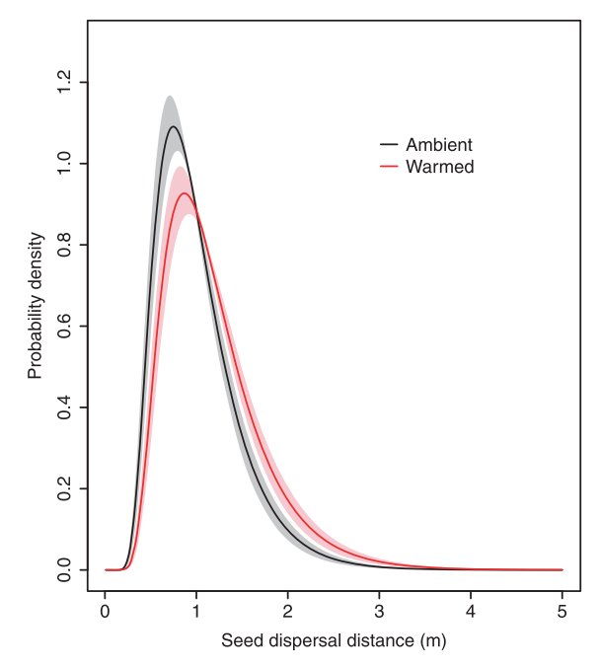
Study System & Methods
Previous studies have shown that, at least in C. nutans, that warming increases plant height and shifts dispersal kernels to the right. However…
Image source: Zhang et al (2011)

Slide 30
Study System & Methods
Previous studies have shown that, at least in C. nutans, that warming increases plant height and shifts dispersal kernels to the right. However…
This is not as clear for C. acanthoides.
Also, previous studies have only considered seed release as a single point source at the maximum flower height; what about the other release heights?
Image source: Zhang et al (2011)

Slide 31
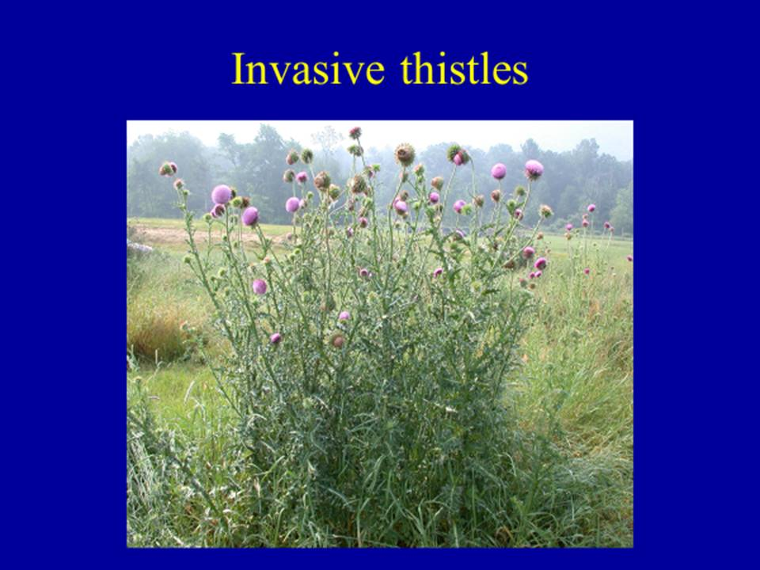
Study System & Methods
Previous studies used the maximum point of seed release (i.e. the highest flower head) on each plant to calculate dispersal kernels.
Image source: K. Shea

Slide 32
Study System & Methods
Previous studies used the maximum point of seed release (i.e. the highest flower head) on each plant to calculate dispersal kernels.
But seeds release from a variety of different heights on the same plant!
How does the dispersal kernel change when accounting for all seed release heights on an individual?
Image source: K. Shea

Slide 33
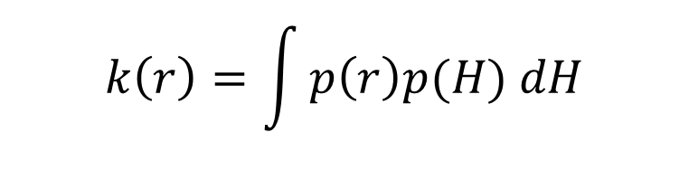
Study System & Methods
Previous studies used the maximum point of seed release (i.e. the highest flower head) on each plant to calculate dispersal kernels.
But seeds release from a variety of different heights on the same plant!
How does the dispersal kernel change when accounting for all seed release heights on an individual?
$$k\left(r\right)=\int{p\left(r\right)p(H) dH}$$
Image source: K. Shea

Slide 34
Study System & Methods
Research questions
How does increased temperature affect the distribution of flower head heights (and thus seed release heights)?
How does increased temperature affect dispersal distances over the distribution of flower head heights?
Are there differences in dispersal when using the distribution of seed release heights rather than the maximum height?

Slide 35
Results
Background & Introduction
Study System & Methods
Image source: O. Skarpaas
Results
Discussion & Conclusions
Image source: brc.ac.uk
Image source: web.ewu.edu

Slide 36
Results
Research questions
How does increased temperature affect the distribution of flower head heights (and thus seed release heights)?
How does increased temperature affect dispersal distances over the distribution of flower head heights?
Are there differences in dispersal when using the distribution of seed release heights rather than the maximum height?

Slide 37
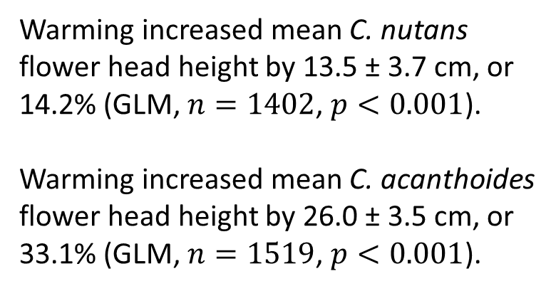
Results
For each species, warming results in a rightward shift in flower head height distribution…
*Bands represent 95% bootstrap interval; Kolmogorov-Smirnov test used to determine if distributions are distinct
Warming increased mean C. nutans flower head height by 13.5 ± 3.7 cm, or 14.2% (GLM, $n=1402$, $p<0.001$).
Warming increased mean C. acanthoides flower head height by 26.0 ± 3.5 cm, or 33.1% (GLM, $n=1519$, $p<0.001$).

Slide 38
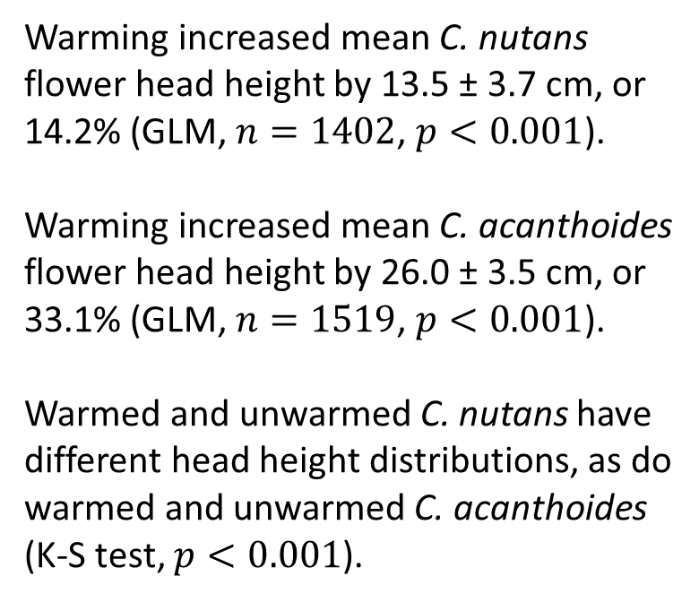
Results
For each species, warming results in a rightward shift in flower head height distribution…
*Bands represent 95% bootstrap interval; Kolmogorov-Smirnov test used to determine if distributions are distinct
Warming increased mean C. nutans flower head height by 13.5 ± 3.7 cm, or 14.2% (GLM, $n=1402$, $p<0.001$).
Warming increased mean C. acanthoides flower head height by 26.0 ± 3.5 cm, or 33.1% (GLM, $n=1519$, $p<0.001$).
Warmed and unwarmed C. nutans have different head height distributions, as do warmed and unwarmed C. acanthoides (K-S test, $p<0.001$).

Slide 39
Results
Research questions
How does increased temperature affect the distribution of flower head heights (and thus seed release heights)?
How does increased temperature affect dispersal distances over the distribution of flower head heights?
Are there differences in dispersal when using the distribution of seed release heights rather than the maximum height?

Slide 40
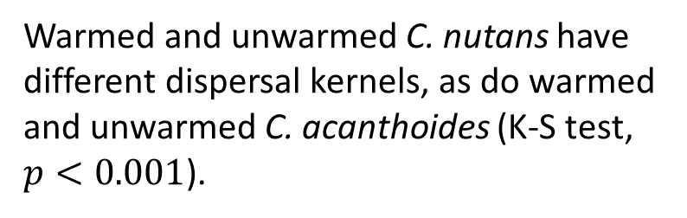
Results
For each species, height changes from warming result in a different dispersal kernel…
*Bands represent 95% bootstrap interval; Kolmogorov-Smirnov test used to test whether distributions are distinct
Warmed and unwarmed C. nutans have different dispersal kernels, as do warmed and unwarmed C. acanthoides (K-S test, $p<0.001$).

Slide 41
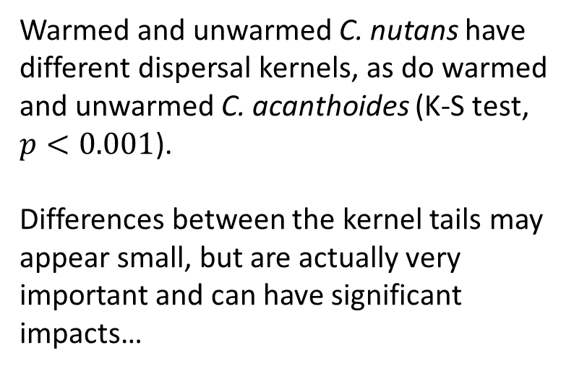
Results
For each species, height changes from warming result in a different dispersal kernel…
*Bands represent 95% bootstrap interval; Kolmogorov-Smirnov test used to test whether distributions are distinct
Warmed and unwarmed C. nutans have different dispersal kernels, as do warmed and unwarmed C. acanthoides (K-S test, $p<0.001$).
Differences between the kernel tails may appear small, but are actually very important and can have significant impacts…

Slide 42
Results
For each species, height changes from warming increase the relative probability of dispersed seeds exceeding a given distance…
*Bands represent 95% bootstrap interval
For both C. nutans and C. acanthoides, the relative chance of a propagule exceeding a given distance when originating from a warmed plant rather than an unwarmed one increases with increasing dispersal distance.

Slide 43
Results
For each species, height changes from warming increase the relative probability of dispersed seeds exceeding a given distance…
*Bands represent 95% bootstrap interval
For both C. nutans and C. acanthoides, the relative chance of a propagule exceeding a given distance when originating from a warmed plant rather than an unwarmed one increases with increasing dispersal distance.
Uncertainty of this risk ratio become extremely high at longer dispersal distances.

Slide 44
Results
Research questions
How does increased temperature affect the distribution of flower head heights (and thus seed release heights)?
How does increased temperature affect dispersal distances over the distribution of flower head heights?
Are there differences in dispersal when using the distribution of seed release heights rather than the maximum height?

Slide 45
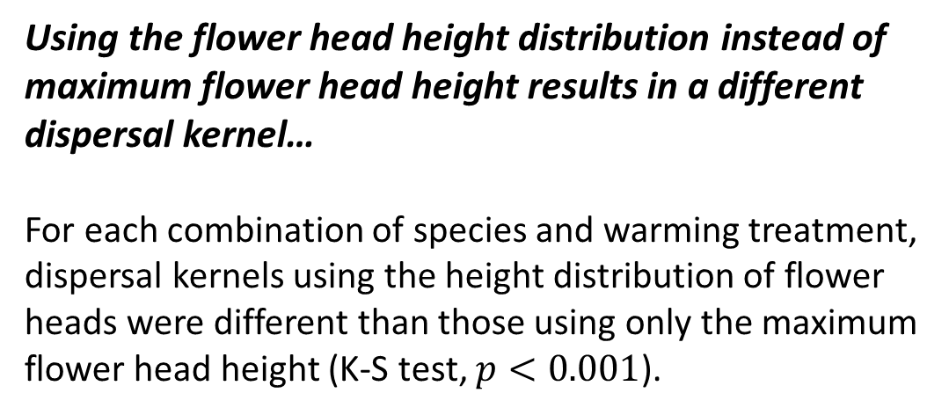
Results
*Bands represent 95% bootstrap interval; Kolmogorov-Smirnov test used to test whether distributions are distinct
Using the flower head height distribution instead of maximum flower head height results in a different dispersal kernel…
For each combination of species and warming treatment, dispersal kernels using the height distribution of flower heads were different than those using only the maximum flower head height (K-S test, $p<0.001$).

Slide 46
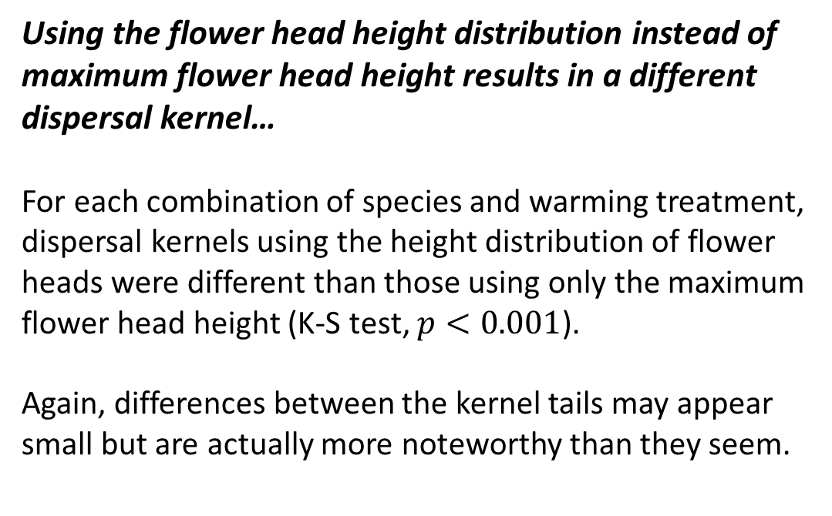
Results
*Bands represent 95% bootstrap interval; Kolmogorov-Smirnov test used to test whether distributions are distinct
Using the flower head height distribution instead of maximum flower head height results in a different dispersal kernel…
For each combination of species and warming treatment, dispersal kernels using the height distribution of flower heads were different than those using only the maximum flower head height (K-S test, $p<0.001$).
Again, differences between the kernel tails may appear small but are actually more noteworthy than they seem.

Slide 47
Results
*Bands represent 95% bootstrap interval
Using the maximum flower head height rather than the flower head height distribution increases the relative probability of dispersed seeds exceeding a given distance…
For each combination of species and warming treatment, the relative chance of a propagule exceeding a given distance when using maximum flower head height rather than the flower head height distribution increases with increasing dispersal distance.

Slide 48
Results
*Bands represent 95% bootstrap interval
Using the maximum flower head height rather than the flower head height distribution increases the relative probability of dispersed seeds exceeding a given distance…
For each combination of species and warming treatment, the relative chance of a propagule exceeding a given distance when using maximum flower head height rather than the flower head height distribution increases with increasing dispersal distance.
Again, uncertainty of this risk ratio become extremely high at longer dispersal distances.

Slide 49
Discussion & Conclusions
Background & Introduction
Study System & Methods
Image source: O. Skarpaas
Results
Discussion & Conclusions
Image source: brc.ac.uk
Image source: web.ewu.edu

Slide 50
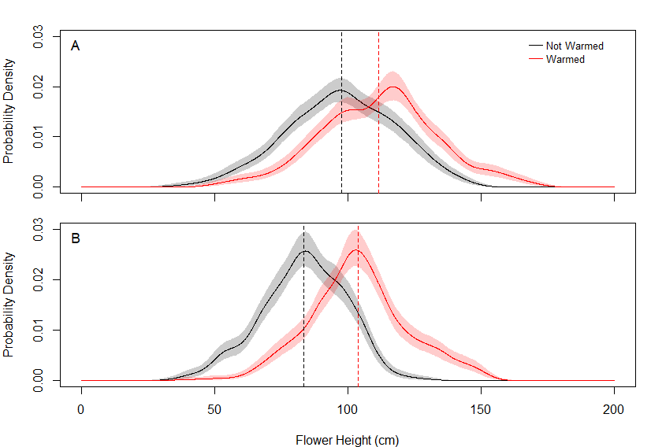
Discussion & Conclusions
How warming affects height…
This is the first study to examine the distributions of seed release heights over the entire plant for C. nutans and C. acanthoides, and how warming affects those distributions.

Slide 51
Discussion & Conclusions
How warming affects height…
This is the first study to examine the distributions of seed release heights over the entire plant for C. nutans and C. acanthoides, and how warming affects those distributions.
Our results show that warming shifts both distributions to the right, increasing seed release heights. Previous studies showed this shift with the maximum flower height; now we show this shift with the entire flower height distribution.

Slide 52
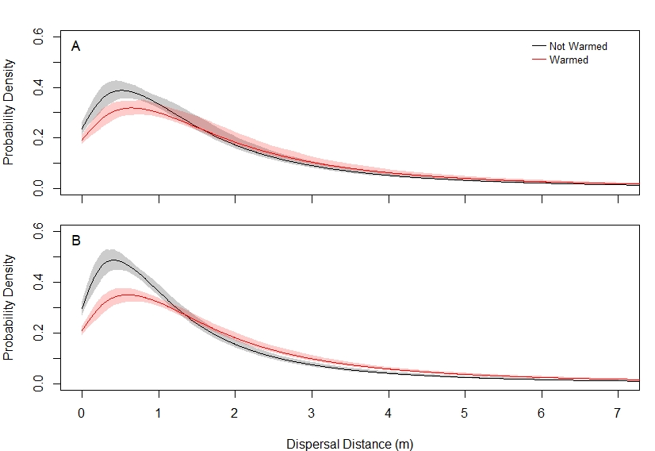
Discussion & Conclusions
… and overall dispersal
As was seen in the previous study, warming changes the dispersal kernel.

Slide 53
Discussion & Conclusions
… and overall dispersal
As was seen in the previous study, warming changes the dispersal kernel.
Here, our results show that even when using the entire height distribution instead of the max height, warming shifts the dispersal kernel to the right and makes the tail “fatter”… dispersal at shorter distances becomes less common, while dispersal at longer distances becomes more common.

Slide 54
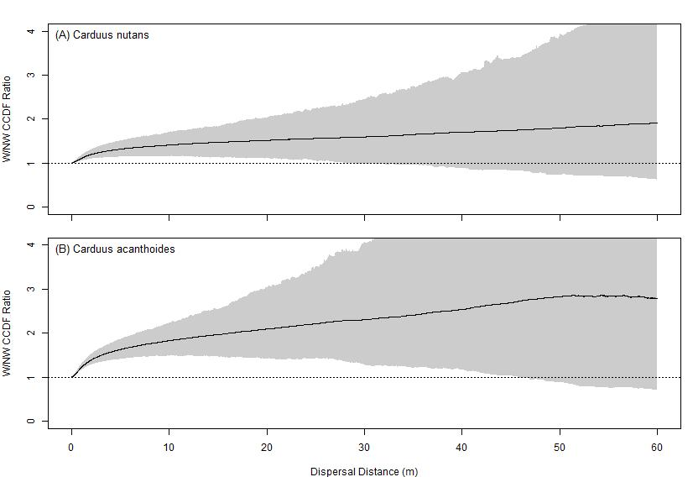
Discussion & Conclusions
… and long-distance dispersal
Warming increases the magnitude of long-distance dispersal events.
This increase becomes more pronounced when looking at more rare dispersal events…

Slide 55
Discussion & Conclusions
… and long-distance dispersal
Warming increases the magnitude of long-distance dispersal events.
This increase becomes more pronounced when looking at more rare dispersal events…
… but so does the variation in the magnitude of those more rare events.

Slide 56
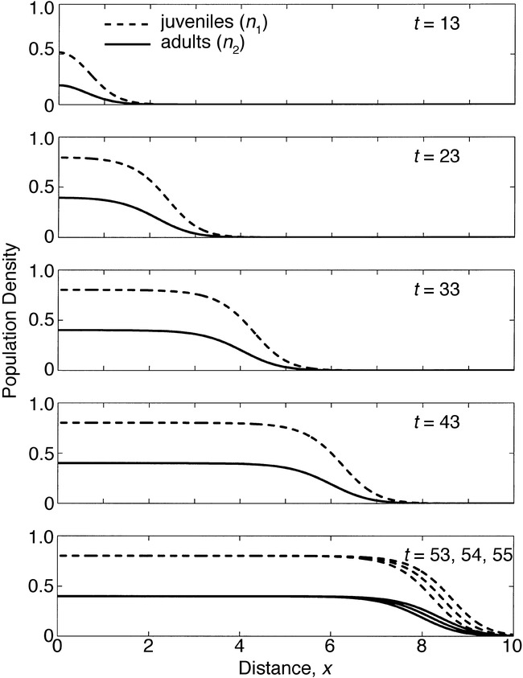
Discussion & Conclusions
… and population spread
Image source: Neubert and Caswell (2000)
These events at the tail end are highly influential in how a population moves across the landscape; models of population spread are often sensitive to these rare events.

Slide 57
Discussion & Conclusions
… and population spread
Image source: Neubert and Caswell (2000)
These events at the tail end are highly influential in how a population moves across the landscape; models of population spread are often sensitive to these rare events.
Thus, warming-induced increases in the magnitude of long-distance dispersal events can increase spread rates. While we have not yet done this with using the entire flower height distribution, increased spread rates have been observed when using max height.

Slide 58
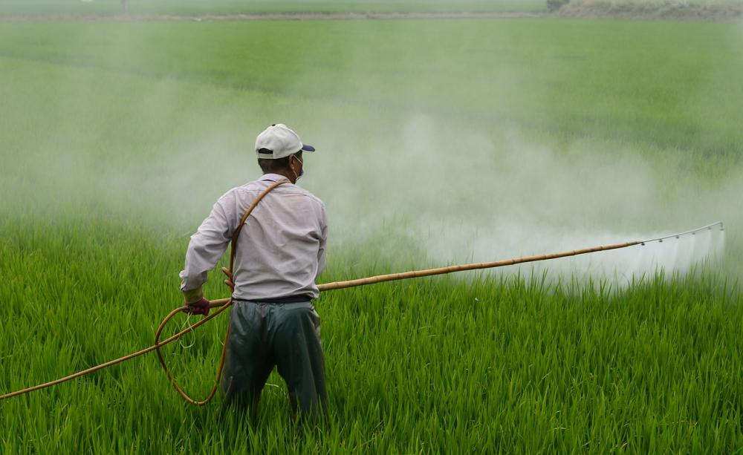
Discussion & Conclusions
Weed management implications
These results have implications for weed management… as warming leads to greater dispersal, the spread of these weeds will be more challenging to control.
Knowing how invasive plants respond to warming can help us continue effective management in future climates.
Image source: Pixabay

Slide 59
References
Beaury, E.M., Fusco, E.J., Jackson, M.R., Laginhas, B.B., Morelli, T.L., Allen, J.M., Pasquarella, V.J. and Bradley, B.A. 2020. Incorporating climate change into invasive species management: insights from managers. Biological Invasions, 22(2), pp.233-252.
Katul, G.G., Porporato, A., Nathan, R., Siqueira, M., Soons, M.B., Poggi, D., Horn, H.S. and Levin, S.A., 2005. Mechanistic analytical models for long-distance seed dispersal by wind. The American Naturalist, 166(3), pp.368-381.
Neubert, M.G. and Caswell, H., 2000. Demography and dispersal: calculation and sensitivity analysis of invasion speed for structured populations. Ecology, 81(6), pp.1613-1628.
Skarpaas, O. and Shea, K., 2007. Dispersal patterns, dispersal mechanisms, and invasion wave speeds for invasive thistles. The American Naturalist, 170(3), pp.421-430.
Zhang, R., Jongejans, E. and Shea, K., 2011. Warming increases the spread of an invasive thistle. PLoS One, 6(6).

Slide 60
Questions?
Ask them in-call
Post them in the chat
Email them to me at thd5066@psu.edu
Image source: O. Skarpaas
Many thanks to the Shea Lab for providing resources, guidance, and feedback!

